Slide 1
Euclid's Algorithm for Sets

Slide 2
We now consider a generalization of Euclid's algorithm that I find elegant. It
computes the gcd of a set of numbers, rather than of just two numbers.
The algorithm, which computes the gcd of a non-empty set Input of positive
integers, uses a single variable S. Its informal description is:
1.Start with S equal to Input.
2.While S has more than one element, choose elements x and y in S with
y > x , remove y from S and insert y - x in S.
3.If S contains a single element, that element is SetGCD(Input).

Slide 3
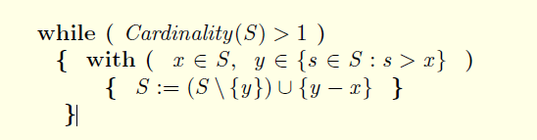
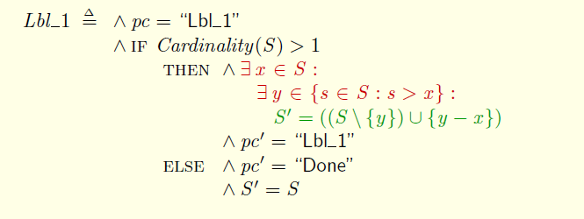
Here is the complete body ofthe algorithm:

Slide 4
Partial correctness of Euclid's algorithm, which asserts that on termination
S contains the single element SetGCD(Input), is expressed by the
invariance of:

Slide 5
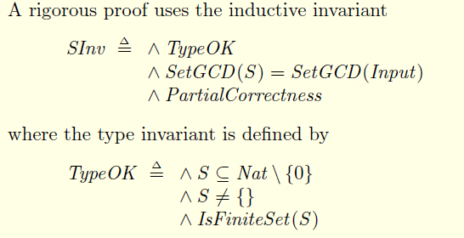
The proof of partial correctness is analogous to that of algorithm Euclid

Slide 6

Rewrite the algorithm without using the Cardinality operator, so answer
partial correctness is true even for infinite sets Input. (The rewritten
algorithm obviously does not terminate if Input is an infinite set.)

Slide 7
define the sum of all the elements of S:
1.The sum of the empty set is 0.
2.The sum of a non-empty set T of integers is the sum of some element t in
T plus the sum of the elements in T \ {t}.
RECURSIVE SetSum(_)
SetSum(T) == IF T = { } THEN 0
ELSE LET t == CHOOSE x \in T : TRUE
IN t + SetSum(T \ {t})

Slide 8
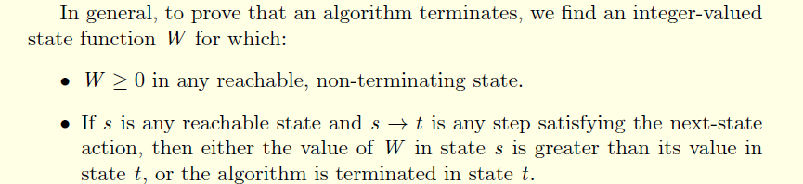
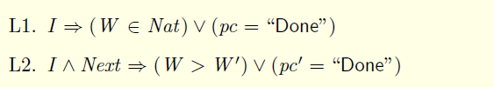
we can prove termination by finding a state function W
and an invariant I of the algorithm satisfying:

Slide 9
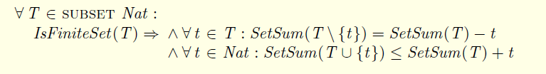

Slide 10
Show that the correctness of algorithm SetEuclid implies the answer
following important result from number theory. The gcd of a set {n₁,...,n_{k}}
of positive integers equals i₁*n₁+...+i_{k}*n_{k} for some integers i_{j} .
Take Input to be {n₁,...,n_{k}}. The correctness of algorithm SetEuclid implies
that it has some reachable state in which the gcd of Input is an element of S.
Since an invariant is true for all reachable states, the result follows from this
invariant: Every element of S equals i₁*n₁+...+i_{k}*n_{k} , for some integers
i₁,...,i_{k} .It's easy to show that this is an invariant of the algorithm.

Slide 11
THANKS
谢谢聆听

